Slide 1
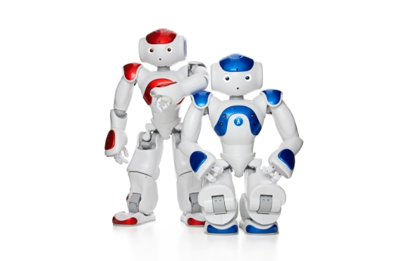
Train robot to climb stairs
21_22-J 34

Slide 2
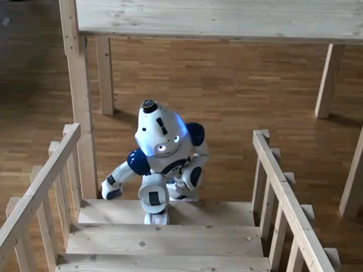
Overall Project Description

Slide 3

Introduction
Robots are made for help of humans.
Nowadays, robots are using in many industries.
The research project is concern about how to train the robot to climb stairs.
Here the selected robot is a humanoid robot.
Surena, Nao, Kime, Pepper

Slide 4
Research Question
When climb stairs
How to detect staircases accurately?
How to get dimensions of steps correctly?
How to move robot’s legs?
How to maintain robot’s body balance?
How to continue safe, speed and smooth move?

Slide 5
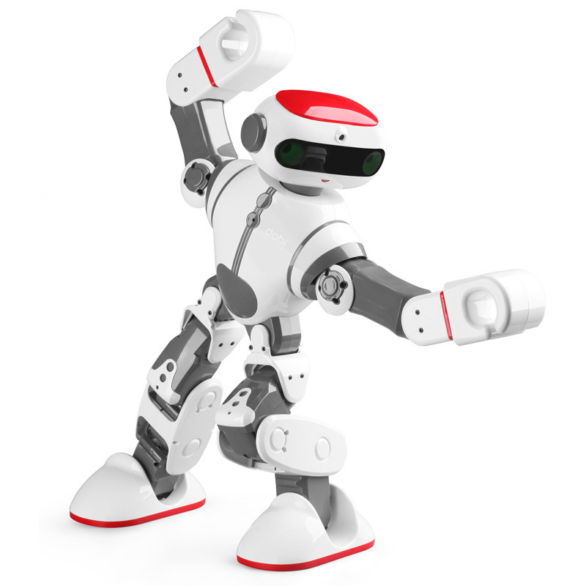
Objectives
Main Objective
Train robot to climb stairs
Sub Objectives
Detect the staircase
Get dimensions of staircase
Move robot’s legs on the staircase
Maintain stability of robot

Slide 6
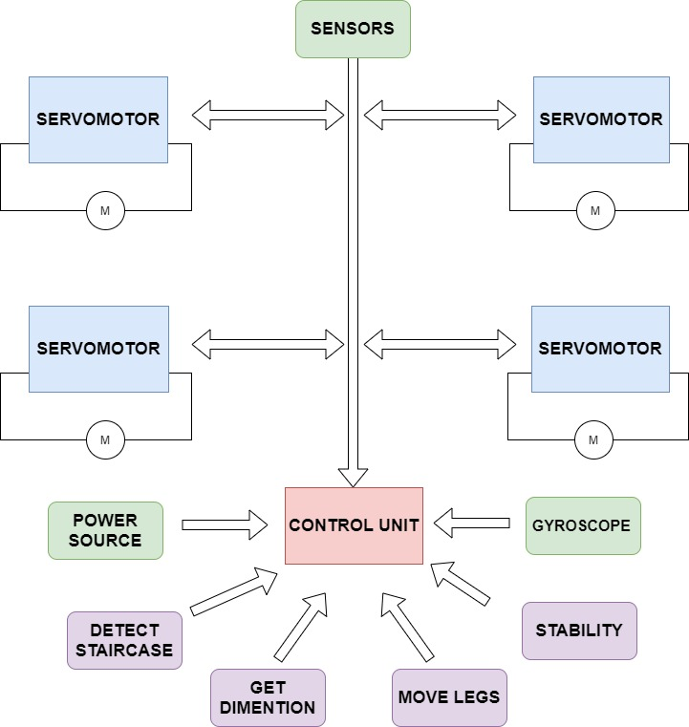
Overall System Diagram

Slide 7

IT18216974 | Jayawardana J.T.H
Specialization in Software Engineering

Slide 8
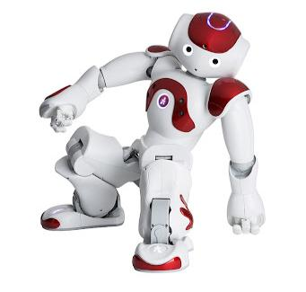
Background
Mainly three approaches are there
Sensor based system
Vision based system
Hybrid system

Slide 9
Research Gap
Many researchers have done different approaches to detect staircases accurately.
According to that researches,
Some robots can detect staircase while moving.
But cannot identify staircase in low light situation.
Robot cannot identify number of steps have to climb without help of humans.

Slide 10
Compare Existing Systems and Related Work
Research | Detect staircase while moving | Support for low light situation | Identify number of steps
Autonomous staircase detection and stair climbing for a tracked mobile robot using fuzzy controller [1] | Yes | No | No
Autonomous climbing of spiral staircases with humanoids[2] | No | No | No
Staircase Detection to Guide Visually Impaired People: A Hybrid Approach [4] | Yes | No | No
Design And Implementation of Autonomous Stair Climbing With NAO Humanoid Robot[6] | No | No | Yes (with human help)
Real-time Object Detection with Deep Learning for Robot Vision on Mixed Reality Device [7] | Yes | No | No
Autonomous RGBD-based Industrial Staircase Localization from Tracked Robots [8] | Yes | No | No
Stairs recognition using stereo vision-based algorithm in NAO robot, [11] | Yes | No | No
Proposed system | Yes | Yes | Yes

Slide 11
Research Question
How to detect staircases accurately?
How to identify low light situations?
How to increase brightness of image?
How to collect a data set?
How to count number of steps in a staircase?

Slide 12
Specific and Sub Objectives
Specific Objectives
Identify staircase
Get number of steps have to climb
Sub Objectives
Consider how to integrate robot camera and sensors to the detection system.
Create staircase structure for train robot.
Create different staircases data set.
Implement a method to store data set and captured images.
Define a model to identify staircase features.
Find out a model to identify number of steps of a staircase.

Slide 13
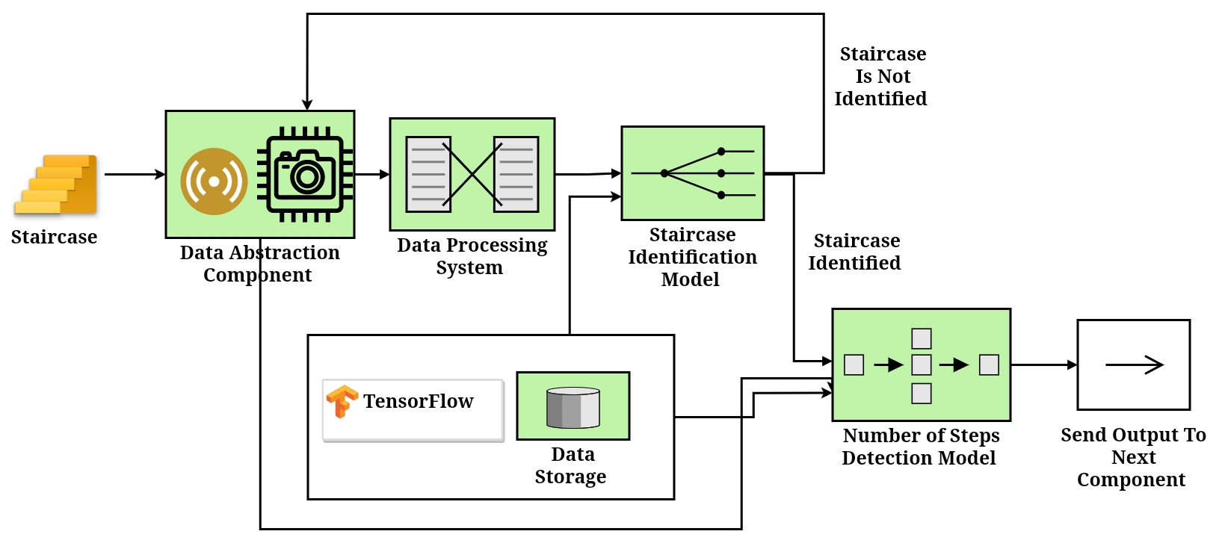
System Diagram

Slide 14

Technologies
Programming Language
Python
For implement the algorithms.
Libraries
Tensorflow
For train image processing model.
OpenCV
For deploy the model to robot environment.
Techniques and Algorithms
Image processing
Canny Edge Detection, CNN, Backpropagation, gradient descent, deep reinforcement learning.

Slide 15
Requirements
User Requirements
Should detect staircase accurately in any situation.
Detection and reaction should be real-time and fast.
Should be support different kind of staircases.
System requirements (For implementation)
Hardware | Software
Core 2 duo or grater cpu | Ubuntu OS
4GB or greater memory | Robot Operating System (robotics middleware suite)
5GB hard space

Slide 16
Requirements contd..
Software Specific Requirements
Functional
Non functional
Capture images
Detect staircases
Get sensors based data
Detect number of steps in a staircase
Sent results to other components
Speed
Accuracy
Maintainability
Light weight

Slide 17
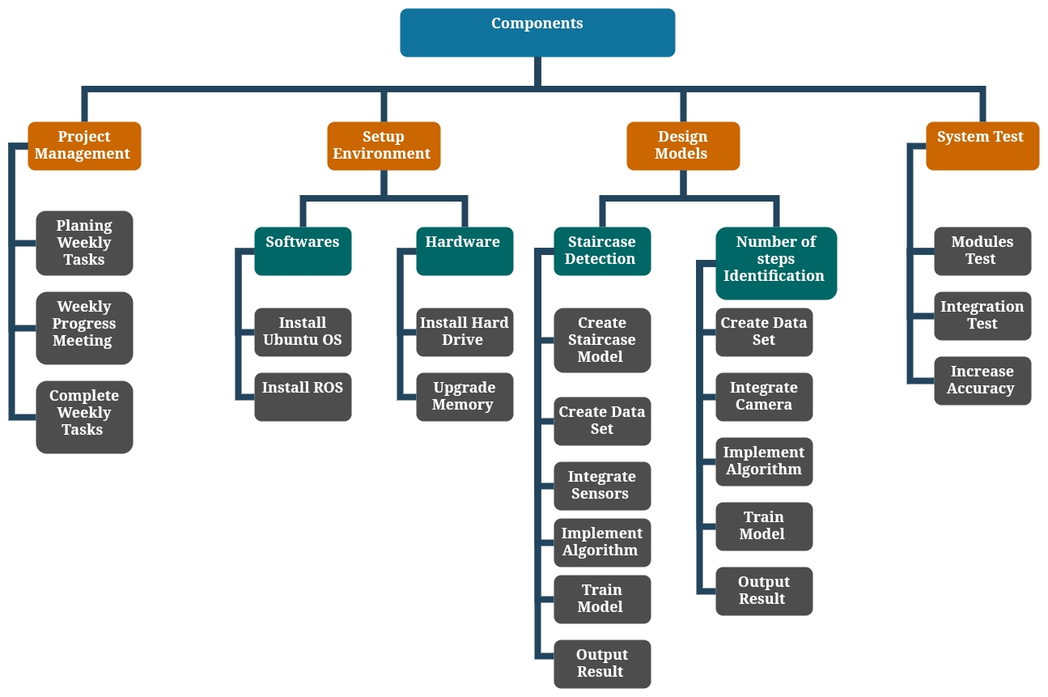
Work Breakdown Structure

Slide 18
Commercialization
User benefits
Detect staircase very accurately quickly in any situation.
Can know total number of steps have to climb before start climb.
Suggesting industries
This system would be very useful for blind persons walking routes detection systems.

Slide 19
References
Reference number | Reference
[1] | E. Mihankhah, A. Kalantari, E. Aboosaeedan, H. D. Taghirad, S. Ali and A. Moosavian, “Autonomous staircase detection and stair climbing for a tracked mobile robot using fuzzy controller,” 2008 IEEE International Conference on Robotics and Biomimetics, 2009, pp. 1980-1985, doi: 10.1109/ROBIO.2009.4913304.
[2] | S. Oßwald, A. Görög, A. Hornung and M. Bennewitz, “Autonomous climbing of spiral staircases with humanoids,” 2011 IEEE/RSJ International Conference on Intelligent Robots and Systems, 2011, pp. 4844-4849, doi: 10.1109/IROS.2011.6094533.
[3] | Alam, Md Nakibul, Md Milon Islam, Md Ahsan Habib, and Motasim Billah Mredul. “Staircase detection systems for the visually impaired people: a review.” International Journal of Computer Science and Information Security (IJCSIS) 16, no. 12 (2018): 13-18.
[4] | Habib, Ahsan, Md Milon Islam, Muhammad Nomani Kabir, Motasim Billah Mredul, and Mahmudul Hasan. “Staircase Detection to Guide Visually Impaired People: A Hybrid Approach.” Rev. d’Intelligence Artif. 33, no. 5 (2019): 327-334.
[5] | W. Lu, “Design And Implementation of Autonomous Stair Climbing With NAO Humanoid Robot,” Master@Vaasa Univ. Appl. Sci., 2015.
[6] | J. Guo, P. Chen, Y. Jiang, H. Yokoi and S. Togo, “Real-time Object Detection with Deep Learning for Robot Vision on Mixed Reality Device,” 2021 IEEE 3rd Global Conference on Life Sciences and Technologies (LifeTech), 2021, pp. 82-83, doi: 10.1109/LifeTech52111.2021.9391811.
[7] | J. FOURRE, V. VAUCHEY, Y. DUPUIS and X. SAVATIER, “Autonomous RGBD-based Industrial Staircase Localization from Tracked Robots,” 2020 IEEE/RSJ International Conference on Intelligent Robots and Systems (IROS), 2020, pp. 10691-10696, doi: 10.1109/IROS45743.2020.9340941.
[8] | A. Singh, S. Yadav and N. Singh, “Contrast enhancement and brightness preservation using global-local image enhancement techniques,” 2016 Fourth International Conference on Parallel, Distributed and Grid Computing (PDGC), 2016, pp. 291-294, doi: 10.1109/PDGC.2016.7913162.
[9] | A. Ma’arif, A. A. Nuryono and Iswanto, “Vision-Based Line Following Robot in Webots,” 2020 FORTEI-International Conference on Electrical Engineering (FORTEI-ICEE), 2020, pp. 24-28, doi: 10.1109/FORTEI-ICEE50915.2020.9249943.
[10] | D. Aguilera-Castro, M. Neira-Cárcamo, C. Aguilera-Carrasco and L. Vera-Quiroga, “Stairs recognition using stereo vision-based algorithm in NAO robot,” 2017 CHILEAN Conference on Electrical, Electronics Engineering, Information and Communication Technologies (CHILECON), 2017, pp. 1-6, doi: 10.1109/CHILECON.2017.8229674.

Slide 20


IT18217100 | dilshan h.v.v
Software Engineering
IT18217100 | Dilshan H.V.V

Slide 21
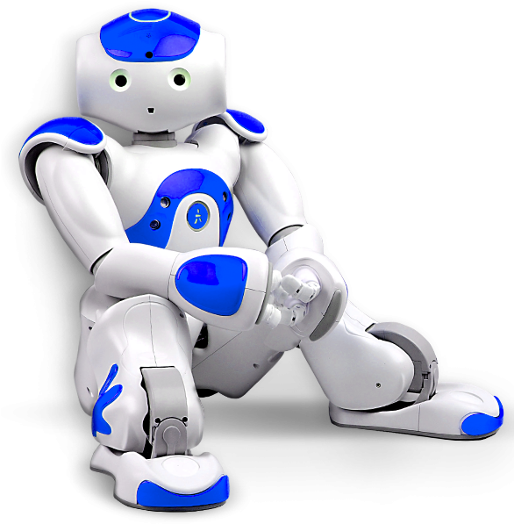
Background
Mainly two approaches are there
Sensor based system
Vision based system
Proposed system
Hybrid system
IT18217100 | Dilshan H.V.V

Slide 22
Research Gap
Many researchers have done different approaches to obtain staircase dimensions.
According to that researches,
Robots obtain dimensions for use by sensors or visons.
But cannot obtain dimensions accurate in low light situation.
The robot cannot identify all stairs have the same dimensions, without getting dimensions as time to time.
IT18217100 | Dilshan H.V.V

Slide 23
Research Gap contd..
[2]
[3]
[8]
Topic – Development Image Processing Technique for Climbing Stair of Small Humaniod Robot.
Authors –W. Samakming and J. Srinonchat
Title - GPU-accelerated real-time 3D tracking for humanoid locomotion and stair climbing.
Authors – P. Michel, J. Chestnutt, S. Kagami, K. Nishiwaki, J. Kuffner and T. Kanade
In this system, accelerated a robust model-based three-dimensional tracking system by programmable graphics hardware to operate online at frame-rate during locomotion of a humanoid robot. this is a vision-based system.
Title – Detection of stair dimensions for the path planning of a bipedal robot.
Authors – Amos Albert, Michael Suppa, Wilfried Gerth
This paper deals with the detection of the characteristics of stairs, the step height, and the step width for online path planning of a bipedal robot. this using a line laser to gather the dimensions of the staircase and using three algorithms to implement.
Laser range finders (LRF) have been used. There are two types of LRFs. That are vertical and horizontal. To obtain dimensions of the staircase used that LRFs and processed when the robot is faced with the staircase at any distance and angle.
IT18217100 | Dilshan H.V.V

Slide 24
Compare Existing Systems and Related Work
Research | Obtain dimensions for use by sensors | Obtain dimensions for use by Visions | Obtain dimensions for use by both (Hybrid) | Support for low light situation | Identify all steps have same dimensions
Autonomous Climbing of Spiral Staircases with Humanoids [1] | Yes | No | No | No | No
GPU-accelerated Real-Time 3D Tracking for Humanoid Locomotion and Stair Climbing[2] | No | Yes | No | No | No
Detection of stair dimensions for the path planning of a bipedal robot [3] | Yes | No | No | No | No
Stair climbing for humanoid robots using stereo vision[5] | No | Yes | No | No | No
Autonomous Staircase Detection and Stair Climbing for a Tracked Mobile Robot using Fuzzy Controller [8] | No | Yes | No | No | No
Proposed system | Yes | Yes | Yes | Yes | Yes
IT18217100 | Dilshan H.V.V

Slide 25
Research Question
How to Identify the dimensions of the staircases more accurately?
How to Identify the dimensions in low light situations?
How to increase brightness of vision?
How to increase accuracy for get dimensions?
How to identify all steps have the same dimensions?
IT18217100 | Dilshan H.V.V

Slide 26
Specific and Sub Objectives
Specific Objectives
Identify staircase corners point
Get dimensions of staircase
Identify stairs have the same dimensions
Sub Objectives
Consider how to integrate robot camera and sensors to the defined dimensions system
Define a model to identify staircase dimensions
Find out a model to identify same dimensions stairs
IT18217100 | Dilshan H.V.V

Slide 27
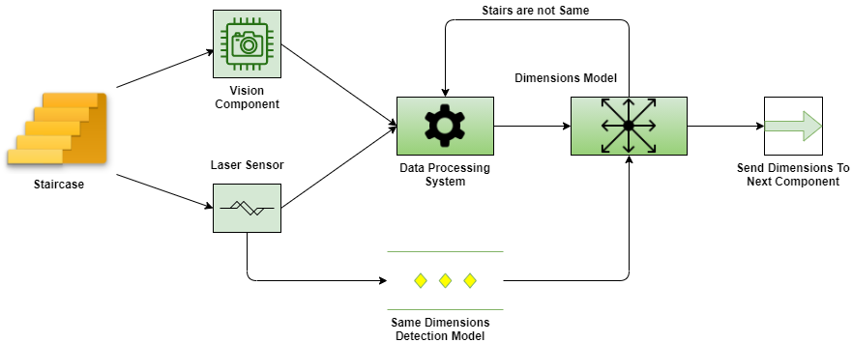
System Diagram
IT18217100 | Dilshan H.V.V

Slide 28

Technologies
Programming Language
Python
For implement the algorithms
Libraries
OpenCV
For deploy the model to robot environment.
Techniques and Algorithms
Image processing
CNN - Convolutional Neural Networks
IT18217100 | Dilshan H.V.V

Slide 29
Requirements
User Requirements
Should identify dimensions of staircase more accurately in any situation.
If not same stairs, identify dimensions of stairs should be real-time and fast.
Should be support different kind of staircases.
System requirements (For implementation)
Hardware | Software
Core 2 duo or grater cpu 4GB or greater memory | Ubuntu OS Robot Operating System (robotics middleware suite)
5GB hard space
IT18217100 | Dilshan H.V.V

Slide 30
Requirements contd..
Software Specific Requirements
Functional
Non functional
Get vision based data
Get sensors based data
Calculate Dimensions of staircase
Identify same stairs or not
Send results to other components
Speed
Accuracy
Maintainability
Light weight
IT18217100 | Dilshan H.V.V

Slide 31
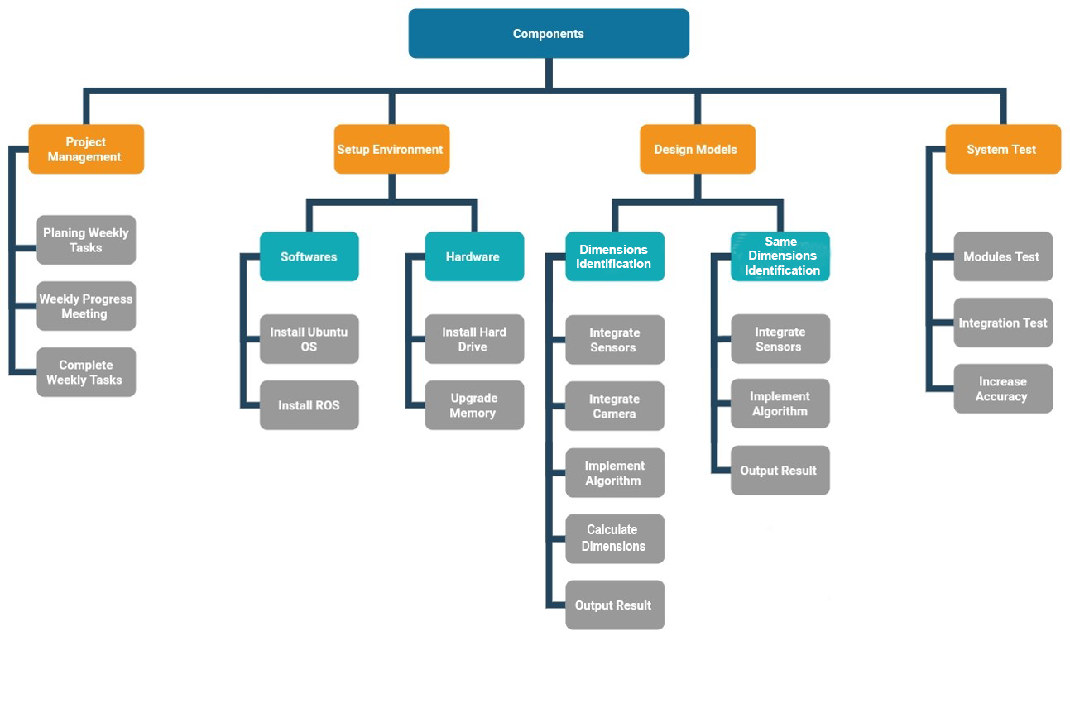
Work Breakdown Structure
IT18217100 | Dilshan H.V.V

Slide 32
References
Reference number | Reference
[1] | S. Oßwald, A. Görög, A. Hornung and M. Bennewitz, "Autonomous climbing of spiral staircases with humanoids," 2011 IEEE/RSJ International Conference on Intelligent Robots and Systems, 2011, pp. 4844-4849, doi: 10.1109/IROS.2011.6094533.
[2] | P. Michel, J. Chestnutt, S. Kagami, K. Nishiwaki, J. Kuffner and T. Kanade, "GPU-accelerated real-time 3D tracking for humanoid locomotion and stair climbing," 2007 IEEE/RSJ International Conference on Intelligent Robots and Systems, 2007, pp. 463-469, doi: 10.1109/IROS.2007.4399104.
[3] | A. Albert, M. Suppa and W. Gerth, "Detection of stair dimensions for the path planning of a bipedal robot," 2001 IEEE/ASME International Conference on Advanced Intelligent Mechatronics. Proceedings (Cat. No.01TH8556), 2001, pp. 1291-1296 vol.2, doi: 10.1109/AIM.2001.936909.
[4] | L.Vesela, "Staircase-dimensions of stair steps and their deviations of geometrical accuracy," IOP Conference Series: Materials Science and Engineering, vol. 471, no. 2, p. 022012, 2019.
[5] | J. -. Gutmann, M. Fukuchi and M. Fujita, "Stair climbing for humanoid robots using stereo vision," 2004 IEEE/RSJ International Conference on Intelligent Robots and Systems (IROS) (IEEE Cat. No.04CH37566), 2004, pp. 1407-1413 vol.2, doi: 10.1109/IROS.2004.1389593.
[6] | H. Zhang, L. Zhang, F. Yuan, G. Bian and S. Xin, "Target Location and Gait Planning for Humanoid Robot Climbing Stairs," 2019 IEEE 4th International Conference on Advanced Robotics and Mechatronics (ICARM), 2019, pp. 888-893, doi: 10.1109/ICARM.2019.8833672.
[7] | L. Zhang, H. Zhang, N. Xiao, T. Zhang, G. B. Bian, "Gait planning and control method for humanoid robot using improved target positioning," Science China Information Sciences, vol. 63, no. 7, pp. 1-3, 2020.
[8] | E. Mihankhah, A. Kalantari, E. Aboosaeedan, H. D. Taghirad, S. Ali and A. Moosavian, “Autonomous staircase detection and stair climbing for a tracked mobile robot using fuzzy controller,” 2008 IEEE International Conference on Robotics and Biomimetics, 2009, pp. 1980-1985, doi: 10.1109/ROBIO.2009.4913304.
[9] | W. Samakming and J. Srinonchat, "Development Image Processing Technique for Climbing Stair of Small Humaniod Robot," 2008 International Conference on Computer Science and Information Technology, 2008, pp. 616-619, doi: 10.1109/ICCSIT.2008.164.
IT18217100 | Dilshan H.V.V

Slide 33

IT18220834 | R.G.K.H Wijethilaka
Information Technology
IT18220834 | WIJETHILAKA R.G.K.H

Slide 34
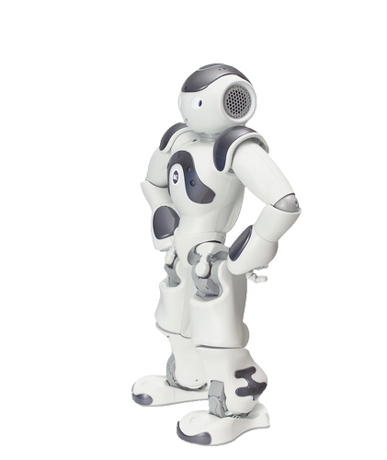
Background
How to climb a robot using legs to the staircases. Motion sensor are used for it.
Moving Robot mainly change three Parts.
Ankle motion
Knee motion
Hip motion
IT18220834 | WIJETHILAKA R.G.K.H

Slide 35

Research Gap
Change legs while moving
Speed of Legs moving
Distance of legs moving
Which angle Ankle moving
IT18220834 | WIJETHILAKA R.G.K.H

Slide 36

Research Question
How to move robot with legs.
How to control speed between legs.
How to correctly move between steps and how to manage distance between legs.
How to manage weight between legs
IT18220834 | WIJETHILAKA R.G.K.H

Slide 37
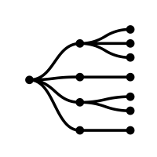
Specific and Sub Objectives
Specific Objectives
Legs Move robot staircases
Sub Objectives
How to move ankle, knee and hip.
How to manage weight between moving legs.
How to manage swing in the right direction legs
How to manage speed of legs
IT18220834 | WIJETHILAKA R.G.K.H

Slide 38
System Diagram
Data Storage
Tempory data between legs moving(distance)
get tempory data (moving speed of leg) and dimention of staircases
Move Right leg use motion senser
Move Left leg use motion senser
IT18220834 | WIJETHILAKA R.G.K.H

Slide 39

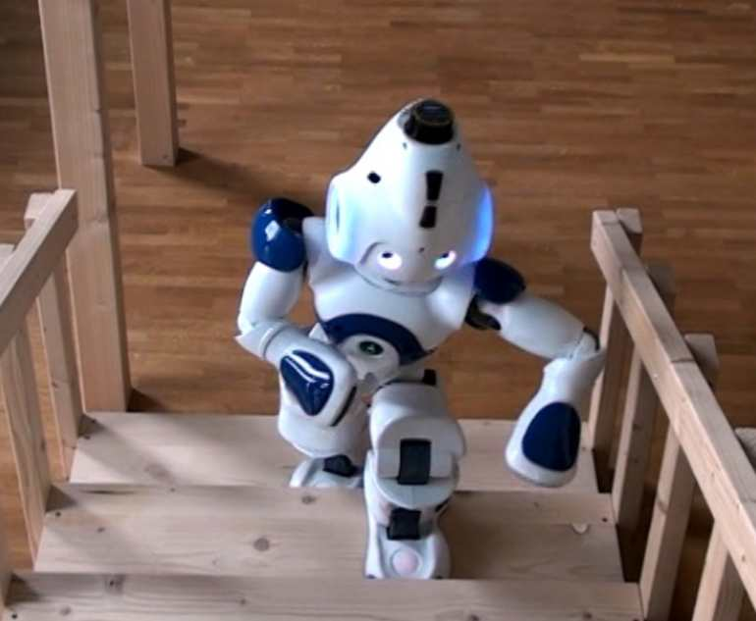
Technologies
Programming Language
- Implement algorithms
Technologies and Algorithms
Motion Sensor
- Motion sensor use move ankle, knee and hip use to climb staircases
Python
IT18220834 | WIJETHILAKA R.G.K.H

Slide 40

Requirements
User Requirements
Moving robot how to manage the weight of other part to the one leg .
Get Realtime data and move legs .
Legs Speed and distance about legs to climb staircases .
System requirements (For implementation)
Core 2 duo or grater cpu.
4GB or greater memory.
5GB hard space.
Ubuntu OS.
Robot Operating System (robotics middleware suite)
IT18220834 | WIJETHILAKA R.G.K.H

Slide 41
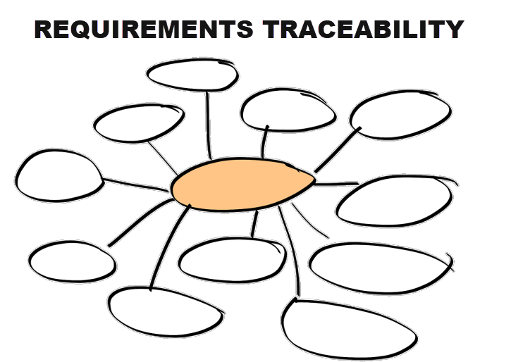
Requirements contd..
Software Specific Requirements
Functional
Weight management between legs and other parts
Legs distance speed
Get data after move right leg after left leg
Get data legs speed of movement
Non functional
Speed
Accuracy
Durability
Performance
requirement
IT18220834 | WIJETHILAKA R.G.K.H

Slide 42
Work Breakdown Structure
Component
Project Management
Setup Environment
Design Models
System Test
Component
Testing
Planning
Legs Move
Software
Hardware
Meetings
Use algorithms to get data set
Overall System Test
Install Ubuntu
Install Harddrive
Reporting
Integrate Sensers
Test Case Reporting
Install Ros
Upgrade Ram
Train model
output
IT18220834 | WIJETHILAKA R.G.K.H

Slide 43
Commercialization
User benefits
How to climb robot to staircases with legs accurately and how to manage weight between legs.
How to get robot real-time data and move legs.
Suggesting industries
This help to people reduce time and increase productivity level.
IT18220834 | WIJETHILAKA R.G.K.H

Slide 44
References
Reference Number | Reference
[1] | S. Oßwald, A. Görög, A. Hornung and M. Bennewitz, "Autonomous climbing of spiral staircases with humanoids," 2011 IEEE/RSJ International Conference on Intelligent Robots and Systems, 2011, pp. 4844-4849, doi: 10.1109/IROS.2011.6094533.
[2] | J. -. Gutmann, M. Fukuchi and M. Fujita, "Stair climbing for humanoid robots using stereo vision," 2004 IEEE/RSJ International Conference on Intelligent Robots and Systems (IROS) (IEEE Cat. No.04CH37566), 2004, pp. 1407-1413 vol.2, doi: 10.1109/IROS.2004.1389593.
[3] | E. Pot, J. Monceaux, R. Gelin and B. Maisonnier, "Choregraphe: a graphical tool for humanoid robot programming," RO-MAN 2009 - The 18th IEEE International Symposium on Robot and Human Interactive Communication, 2009, pp. 46-51, doi: 10.1109/ROMAN.2009.5326209.
[4] | ]. J. Koenemann and M. Bennewitz, "Whole-body imitation of human motions with a Nao humanoid," 2012 7th ACM/IEEE International Conference on Human-Robot Interaction (HRI), 2012, pp. 425-425, doi: 10.1145/2157689.2157830.
[5] | . Lee, J. Lee, D. G. Lee and Y. Oh, "Walking pattern generation in sagittal plane possessing characteristics of human normal walking," 2016 IEEE International Conference on Mechatronics and Automation, 2016, pp. 1066-1072, doi: 10.1109/ICMA.2016.7558710.
[6] | ] G. Chen, B. Hou, S. Guo and J. Wang, "A Guide for Human Walking Model and Control — Insights from Mechanical Property Analysis of Human Walking," 2020 Chinese Control And Decision Conference (CCDC), 2020, pp. 4785-4790, doi: 10.1109/CCDC49329.2020.9164160.
IT18220834 | WIJETHILAKA R.G.K.H

Slide 45

IT18212150 | T.D. Balasooriya
Information Technology
IT18212150 | T.D. BALASOORIYA

Slide 46
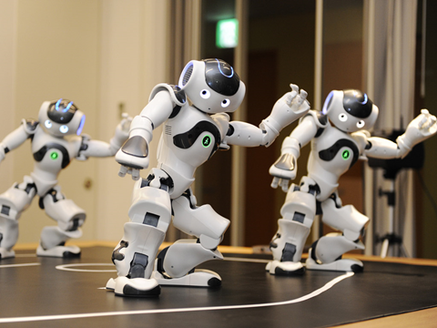
Background
Researchers have done different research about humanoid robot imitating human motion and maintain its stability when climb stairs.
There are three parts to consider mainly.
Motion Capture
Kinematic Operation
Balance Control
IT18212150 | T.D. BALASOORIYA

Slide 47
Research Gap
Maintain robot’s stability while moving
According to researchers, robust stability system is challenging task.
Convert robot’s movements according to human natural motion
IT18212150 | T.D. BALASOORIYA

Slide 48

Research Question
When it starts to walk and climb stairs control it’s stability is the main part
Implement a generate walking pattern.
How to collect data from moving legs
How to identify start of the staircase and end of the staircase
IT18212150 | T.D. BALASOORIYA

Slide 49
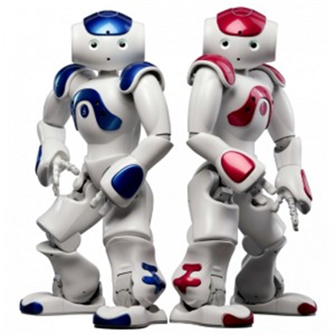
Specific and Sub Objectives
Specific Objectives
Maintain Stability when moving
Define a model for human walking pattern
Sub Objectives
Detect supportive leg
Implement a controller design
Analyze mechanical properties of human walking
Create the human walking modal
Method to get data while moving legs
IT18212150 | T.D. BALASOORIYA

Slide 50
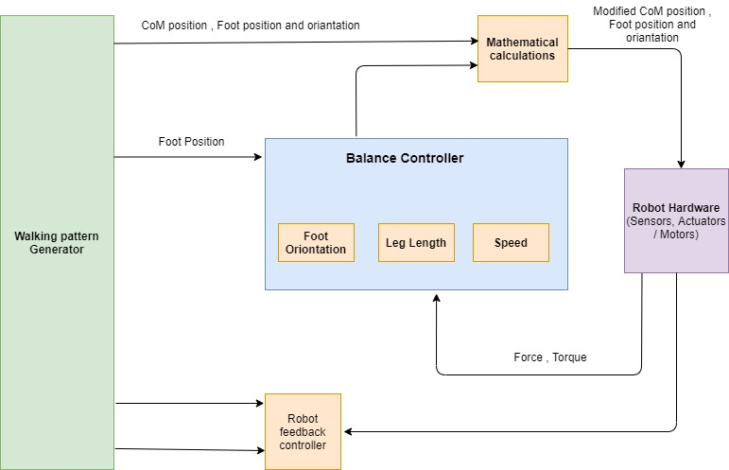
System Diagram
IT18212150 | T.D. BALASOORIYA

Slide 51
Technologies
Programming Language
Python
Libraries
OpenNI and Tensorflow for working with modal in robot environment
Technology
Sensors and Position based control
IT18212150 | T.D. BALASOORIYA

Slide 52
Requirements
User Requirements
Should be able maintain stability when moving as well as climbing staircase
Should be moved according to human walking principles
System requirements (For implementation)
Core 2 duo or grater CPU.
4GB or greater memory.
5GB hard space.
Ubuntu OS.
Robot Operating System (robotics middleware suite)
IT18212150 | T.D. BALASOORIYA

Slide 53
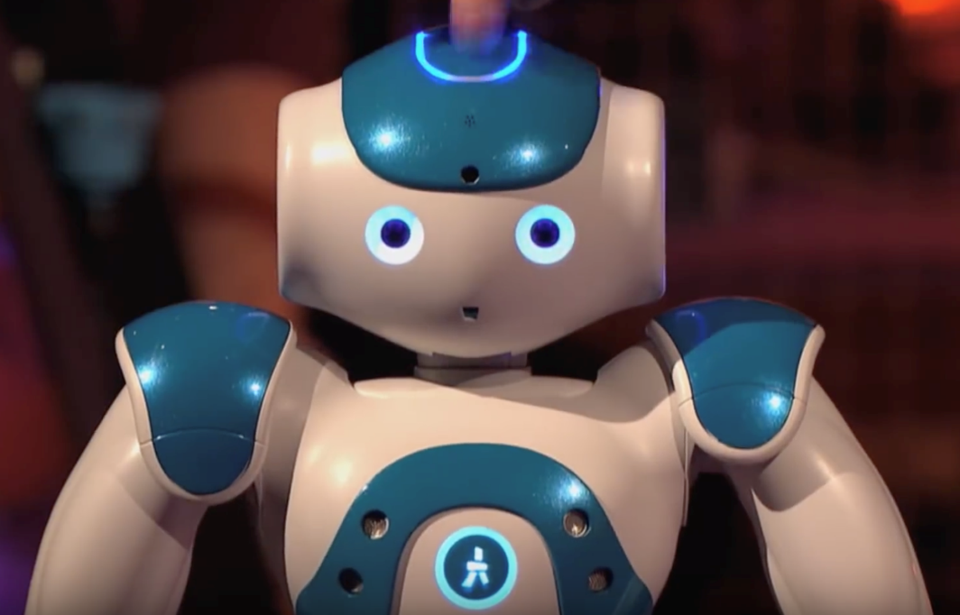
Requirements Cont’d
Software Specific Requirements
Functional
Detect support leg
Get data from sensors
Walk according to human walking modal
Get data from other component
Non-functional
Speed
Maintainability
Durability
IT18212150 | T.D. BALASOORIYA

Slide 54
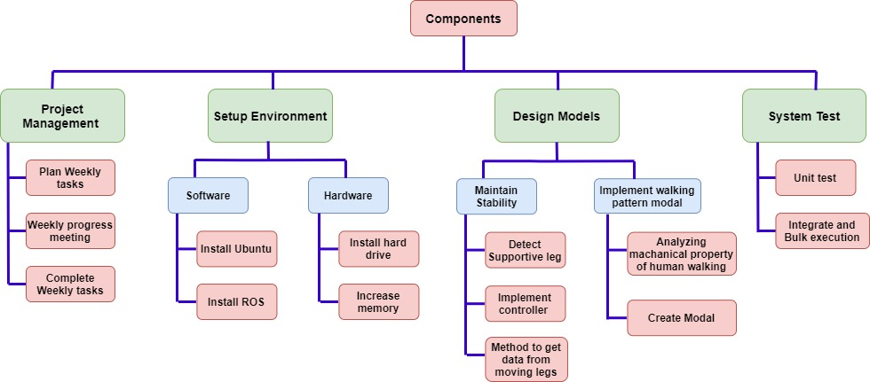
Work Breakdown Structure
IT18212150 | T.D. BALASOORIYA

Slide 55
Commercialization
User benefits
Move robot accurately under any condition reliably
In the industries
This will work efficiently and can help to boost productivity, safety, and time savings in factories.
IT18212150 | T.D. BALASOORIYA

Slide 56
References
Reference Number | Reference
[1] | S. Lee, J. Lee, D. G. Lee and Y. Oh, "Walking pattern generation in sagittal plane possessing characteristics of human normal walking," 2016 IEEE International Conference on Mechatronics and Automation, 2016, pp. 1066-1072, doi: 10.1109/ICMA.2016.7558710.
[2] | G. Chen, B. Hou, S. Guo and J. Wang, "A Guide for Human Walking Model and Control — Insights from Mechanical Property Analysis of Human Walking," 2020 Chinese Control And Decision Conference (CCDC), 2020, pp. 4785-4790, doi: 10.1109/CCDC49329.2020.9164160.
[3] | J. Koenemann and M. Bennewitz, "Whole-body imitation of human motions with a Nao humanoid," 2012 7th ACM/IEEE International Conference on Human-Robot Interaction (HRI), 2012, pp. 425-425, doi: 10.1145/2157689.2157830.
[4] | P. Shahverdi, M. J. Ansari and M. T. Masouleh, "Balance Strategy for Human Imitation by a NAO Humanoid Robot," 2017 5th RSI International Conference on Robotics and Mechatronics (ICRoM), 2017, pp. 138-143, doi: 10.1109/ICRoM.2017.8466225.
[5] | K. Inoue, A. Pripunnochai and T. Wada, "A control method for transfemoral prosthetic knees in level walking and stair ascending based on thigh angular motion," 2016 38th Annual International Conference of the IEEE Engineering in Medicine and Biology Society (EMBC), 2016, pp. 4638-4641, doi: 10.1109/EMBC.2016.7591761.
[6] | S. Caron, A. Kheddar and O. Tempier, "Stair Climbing Stabilization of the HRP-4 Humanoid Robot using Whole-body Admittance Control," 2019 International Conference on Robotics and Automation (ICRA), 2019, pp. 277-283, doi: 10.1109/ICRA.2019.8794348.
IT18212150 | T.D. BALASOORIYA

Slide 57
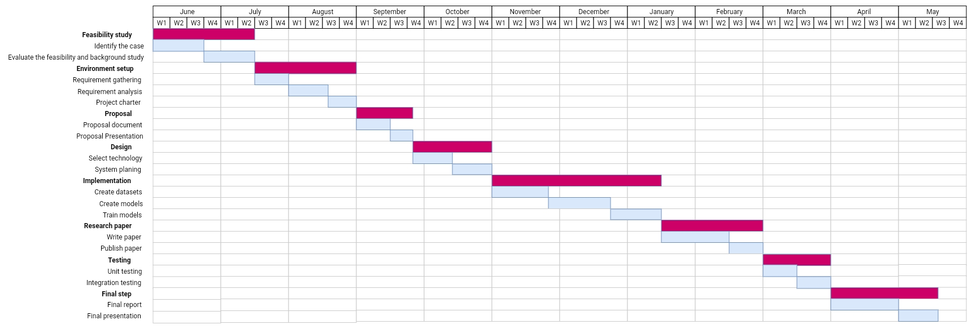
Work Distribution

Slide 58
Budget
Component | Amount (USD) | Amount (LKR)
Frameworks and libraries | Free (0$) | 0 LKR
Internet Package | 30$ | 6000 LKR
Total | 30$ | 6000 LKR

Slide 59
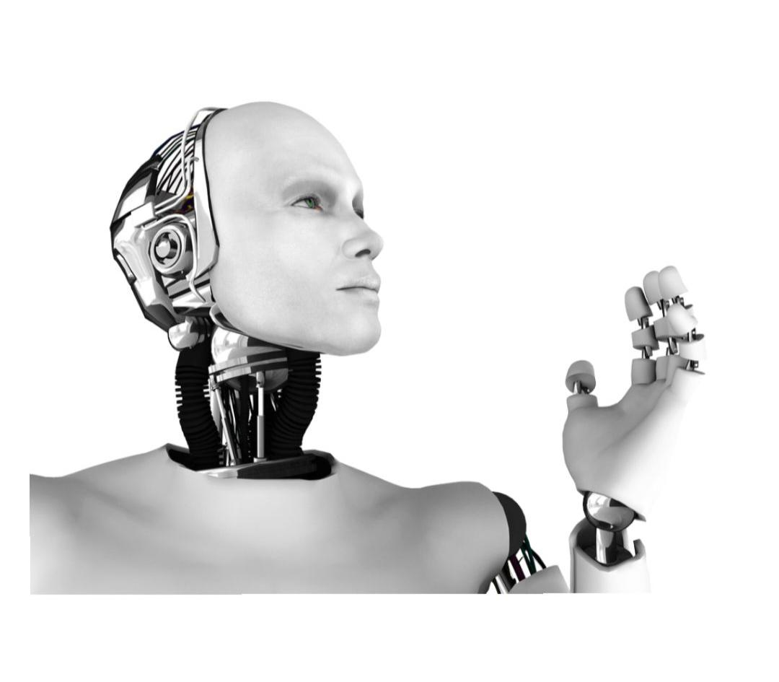
Questions?

